Slide 1



19CSE301 COMPUTER NETWORKS
3-0-0 4

Slide 2

Protocol layers, service models

Slide 3
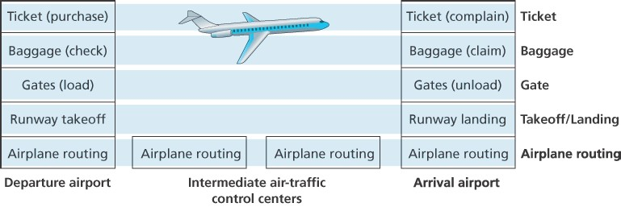
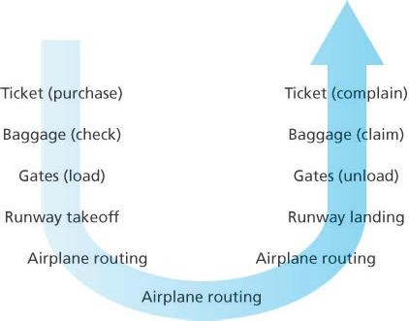
Layering – Analogy- Organization of air travel
services that a layer offers to the layer above—the so-called service model of a layer
Note that each layer, combined with the layers below it, implements some functionality, some service
Network Layering : To provide structure to the design of network protocols, network designers organize protocols—and the network hardware and software that implement the protocols—in layers

Slide 4
Distributed implementation of layer functionality
Departing airport
ticket (purchase)
ticket (complain)
arriving airport
baggage (check)
baggage (claim)
gates (load)
gates (unload)
runway takeoff
runway landing
airplane routing
airplane routing
intermediate air traffic sites
airplane routing
airplane routing
airplane routing
1-4

Slide 5
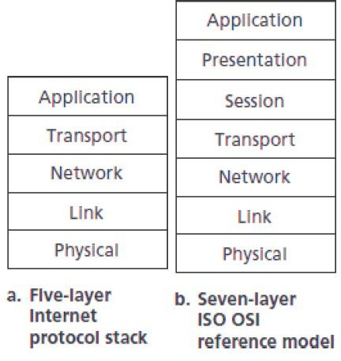
Protocol Layering
A protocol layer can be implemented in software, in hardware, or in a combination of the two.
Application-layer protocols—such as HTTP and SMTP—are almost always implemented in software in the end systems;
so are transport-layer protocols.
Because the physical layer and data link layers are responsible for handling communication over a specific link, they are typically implemented in a network interface card (for example, Ethernet or WiFi interface cards) associated with a given link.
The network layer is often a mixed implementation of hardware and software

Slide 6
Why layering?
Dealing with complex systems:
explicit structure allows identification, relationship of complex
system’s pieces
layered reference model for discussion
modularization eases maintenance, updating of system
change of implementation of layer’s service transparent to rest of
system
e.g., change in gate procedure doesn’t affect rest of system
Introduction
1-6

Slide 7
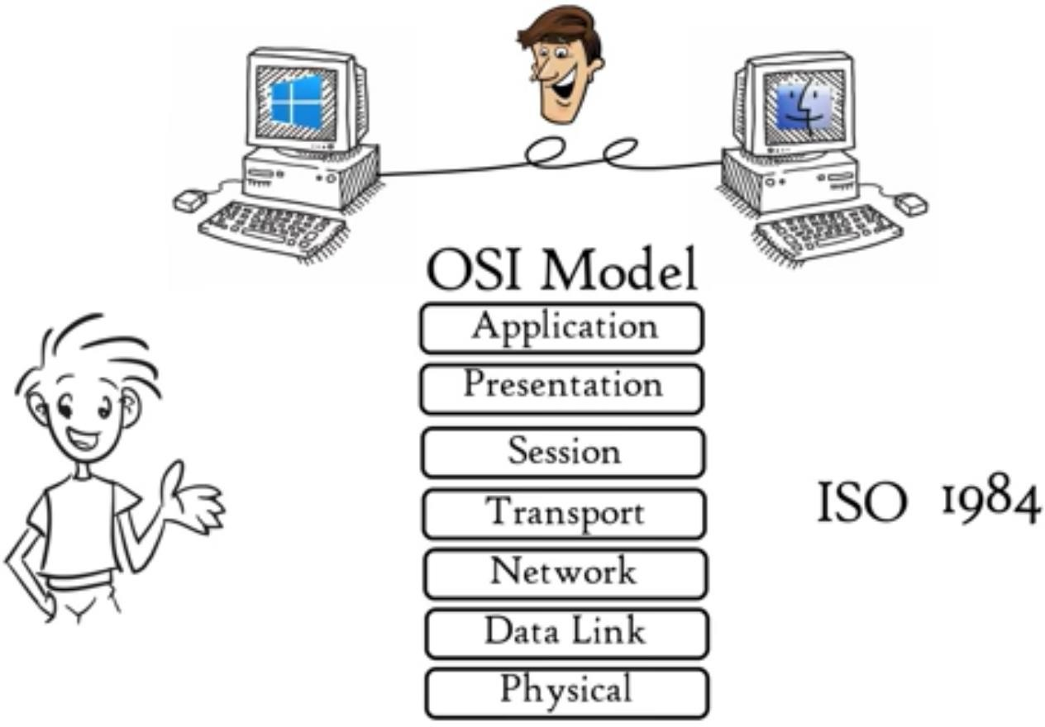
Open System Interconnection Model ( OSI)

Slide 8
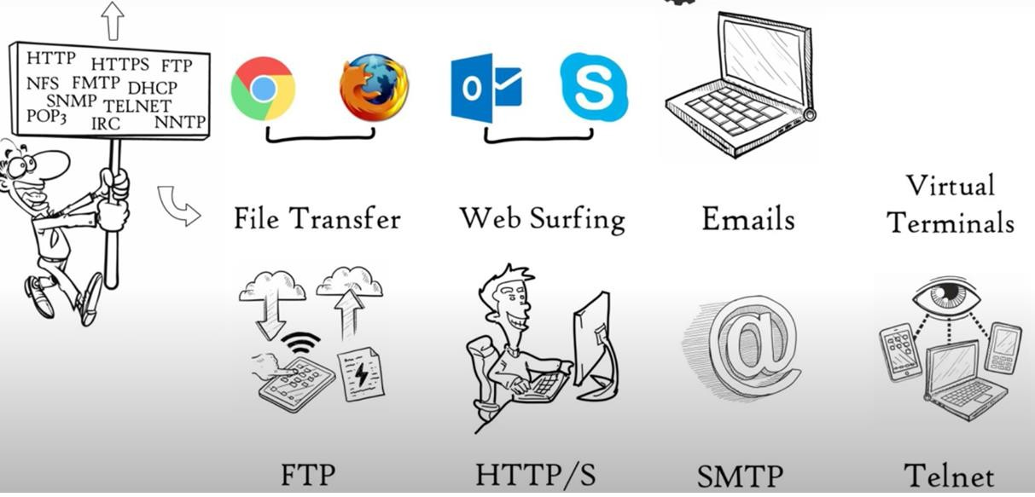
Application Layer
An application-layer protocol is distributed over multiple end systems, with the application in one end system using the protocol to exchange packets of information with the application in another end system.

Slide 9
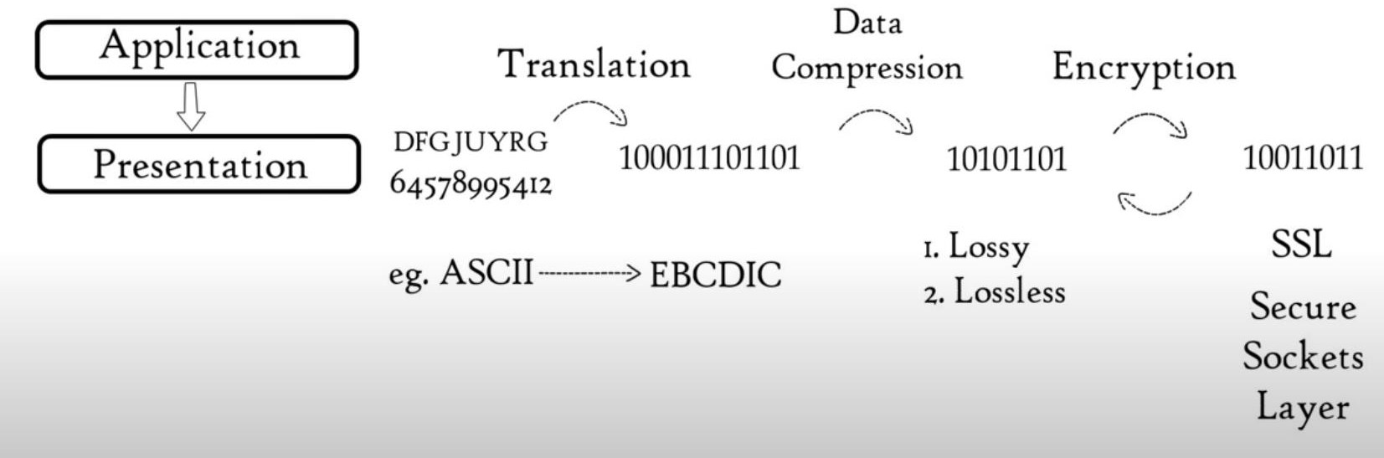
Presentation Layer
Presentation layer is also called the Translation layer.The data from the application layer is extracted here and
manipulated as per the required format to transmit over the network.

Slide 10

Session Layer
Help in Setting up and managing connections enabling sending and receiving of data followed by termination of connection and session

Slide 11
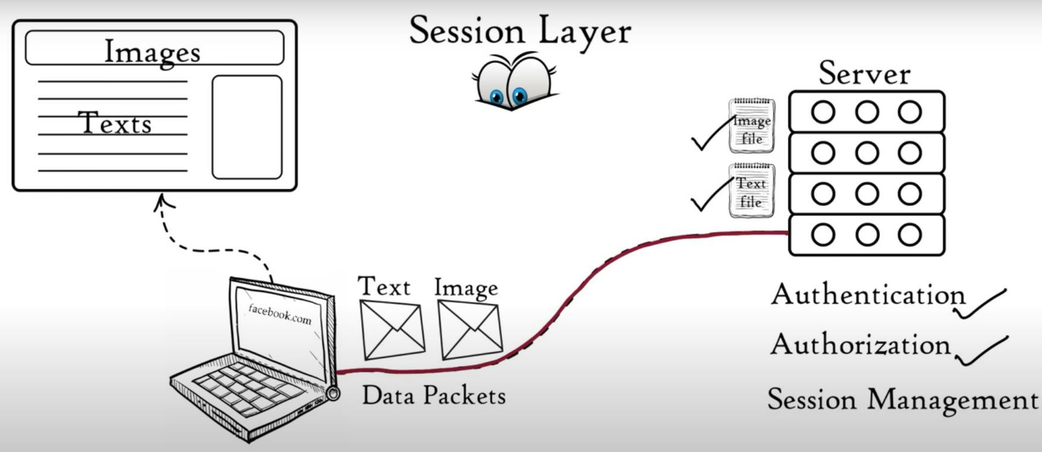
Session Layer

Slide 12
Transport Layer
Transport layer provides services to application layer and takes services from network layer. The data in the transport layer is referred to
as Segments. It is responsible for the End to End Delivery of the complete
message. The transport layer also provides the acknowledgement of the successful data transmission and re-transmits the data if an error is found.
Functions
Segmentation
Flow Control
Error Control
Connection and connectionless transmission

Slide 13
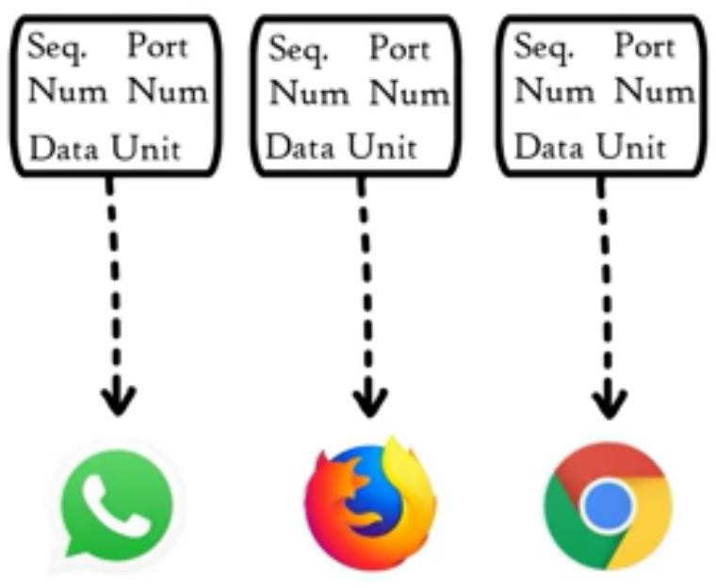
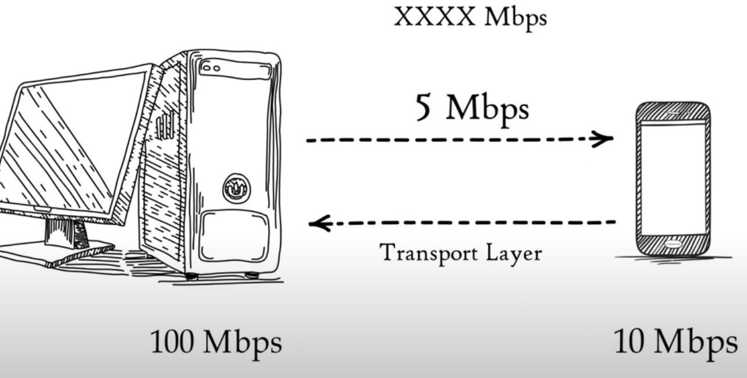
Transport Layer
Segmentation- Segments
Flow Control

Slide 14
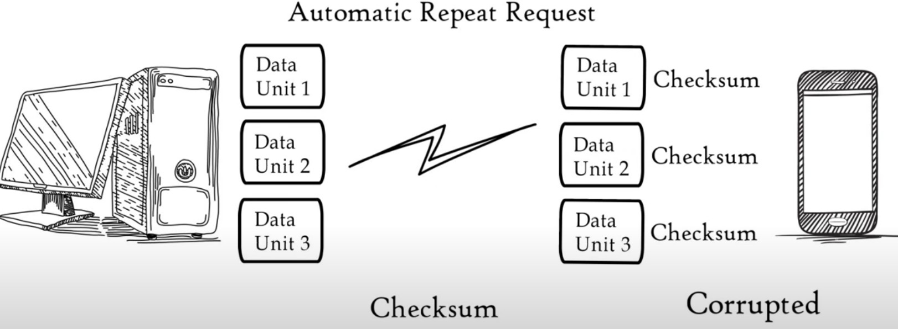

Transport Layer
Error Control

Slide 15
Transport Layer
Connection and connectionless transmission
Protocols
Transmission Control Protocol( TCP) – Connection Oriented
Where all data to be transmitted – Feedback
Used in WWW, Email, FTP, HTTP etc
User datagram protocol (UDP) - Connection Less
Where it doesnot matter we received all data – No Feed back
Movie streaming, Video Games, Trivial File Transfer Protocol (TFTP)- a very simple file transfer, DNS

Slide 16

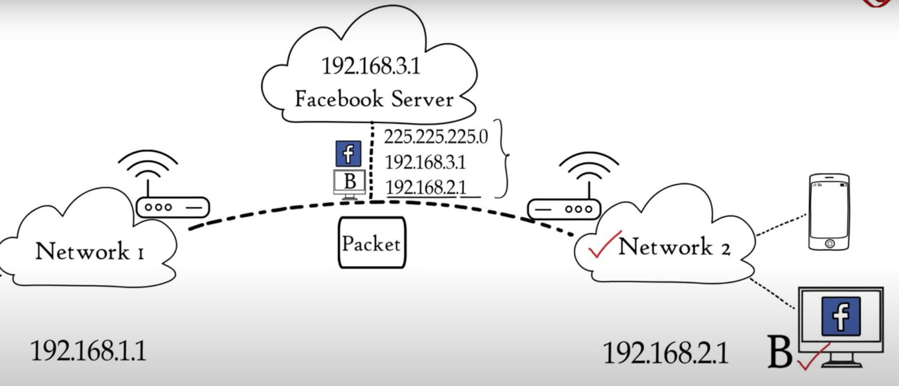
Network Layer
Logical Addressing – IP addressing done in Network Layer
Routing
Path Determination
Network layer assigns senders and receivers IP address to each segment to form a Network layer IP packet
Logical Addressing and Routing

Slide 17
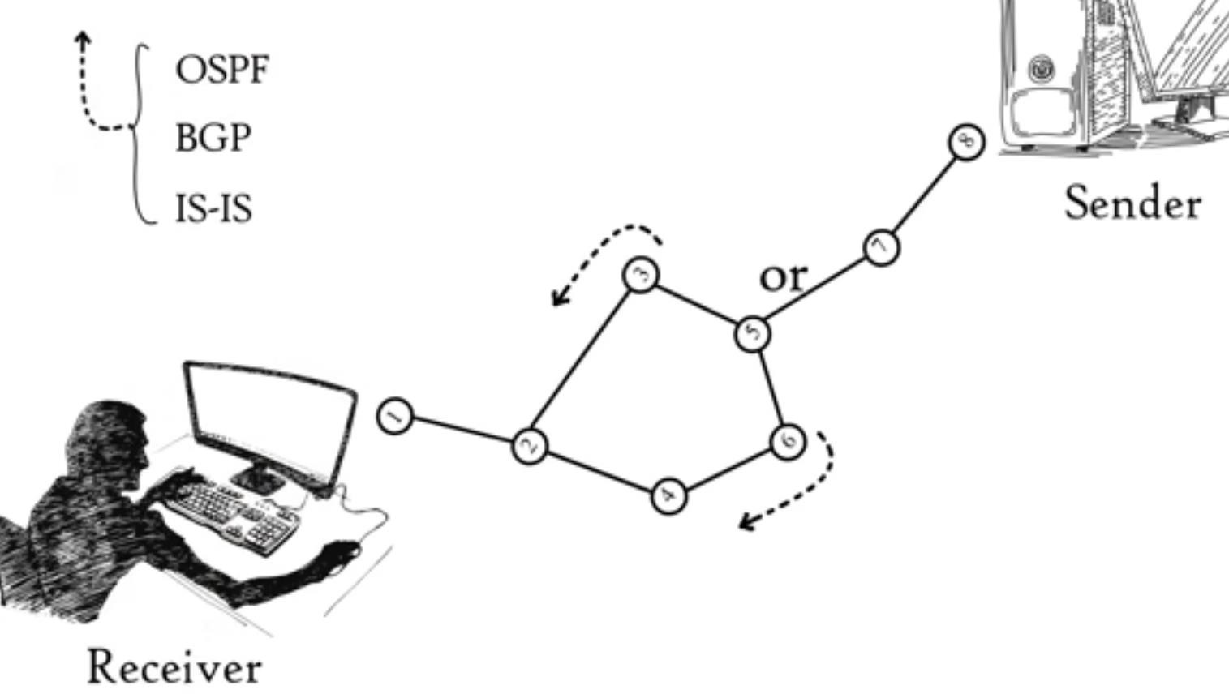
Network Layer
Path Determination
Routing Information Protocol (RIP)
Interior Gateway Protocol (IGRP)
Open Shortest Path First (OSPF)
Exterior Gateway Protocol (EGP)
Enhanced Interior Gateway Routing Protocol (EIGRP)
Border Gateway Protocol (BGP)
Intermediate System-to-Intermediate System (IS-IS)

Slide 18
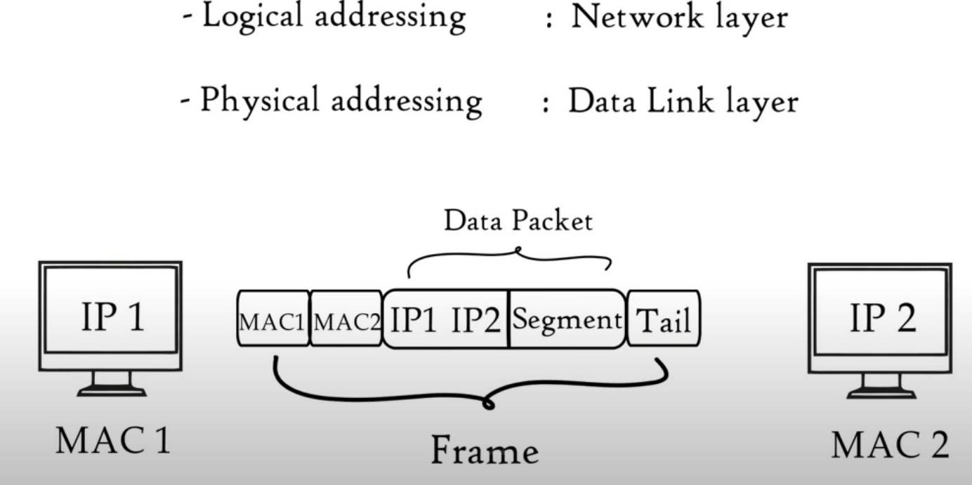
Data Link Layer
The data link layer is responsible for the node to node delivery of the message

Slide 19
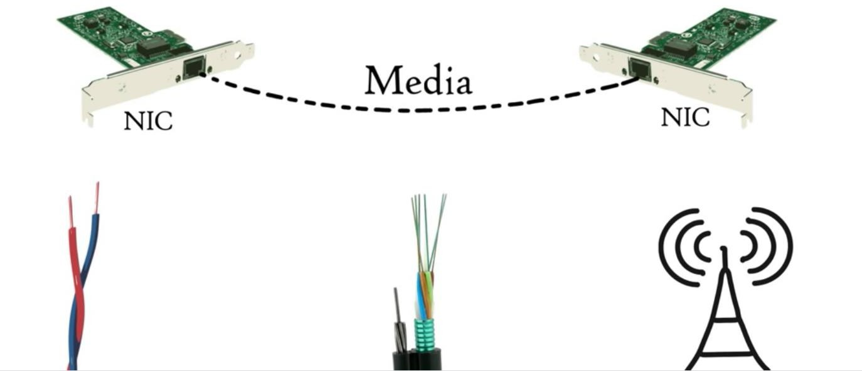
Data Link Layer
MAC address is a 12 digit alphanumeric number embedded in a NIC ( Network Interface Card) of a computer by your computer manufacturer
Data link layer has a software embedded in the NIC card and provides a means to transfer the data frame through a local media ( copper wire/Optical Fibre/Air)
Functions :Data Link Layer
Access the Media (Framing)– Higher layers are able to transfer data with the help of data link layer
– Controls how data is placed and received in the media-
Media Access Control, Error detection

Slide 20
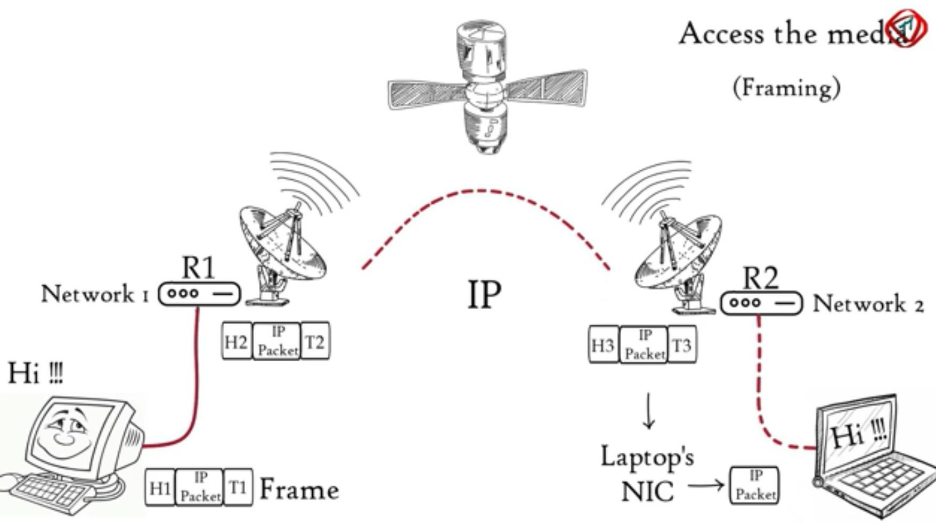
Data Link Layer

Slide 21
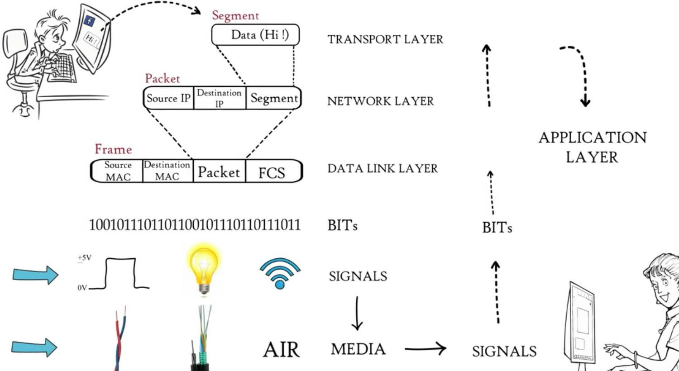
Physical Layer
move the individual bits within the frame from one node to the next.
It is responsible for the actual physical connection between the devices. The physical layer contains information in the form of bits.
It is responsible for transmitting individual bits from one node to the next.
When receiving data, this layer will get the signal received and convert it into 0s and 1s and send them to the Data Link layer, which will put the frame back together.

Slide 22




Note
The physical layer is responsible for movements of individual bits from one hop (node) to the next.

Slide 23
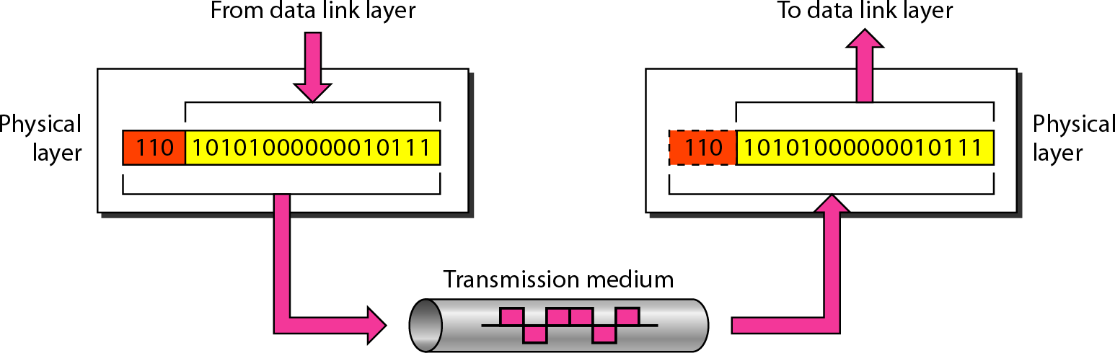
Figure 2.5 Physical layer

Slide 24
Note
The data link layer is responsible for moving frames from one hop (node) to the next.

Slide 25
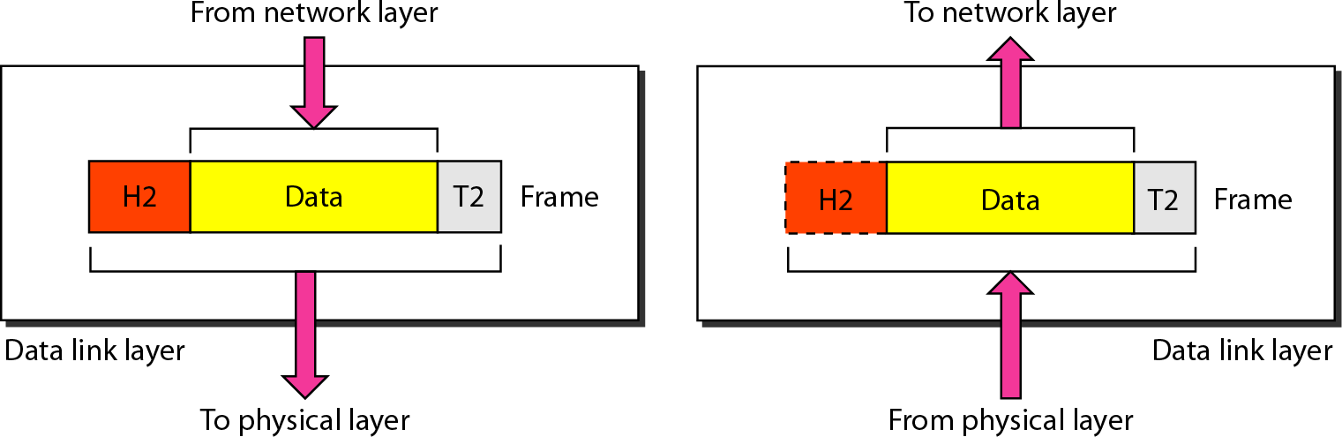
Figure 2.6 Data link layer

Slide 26
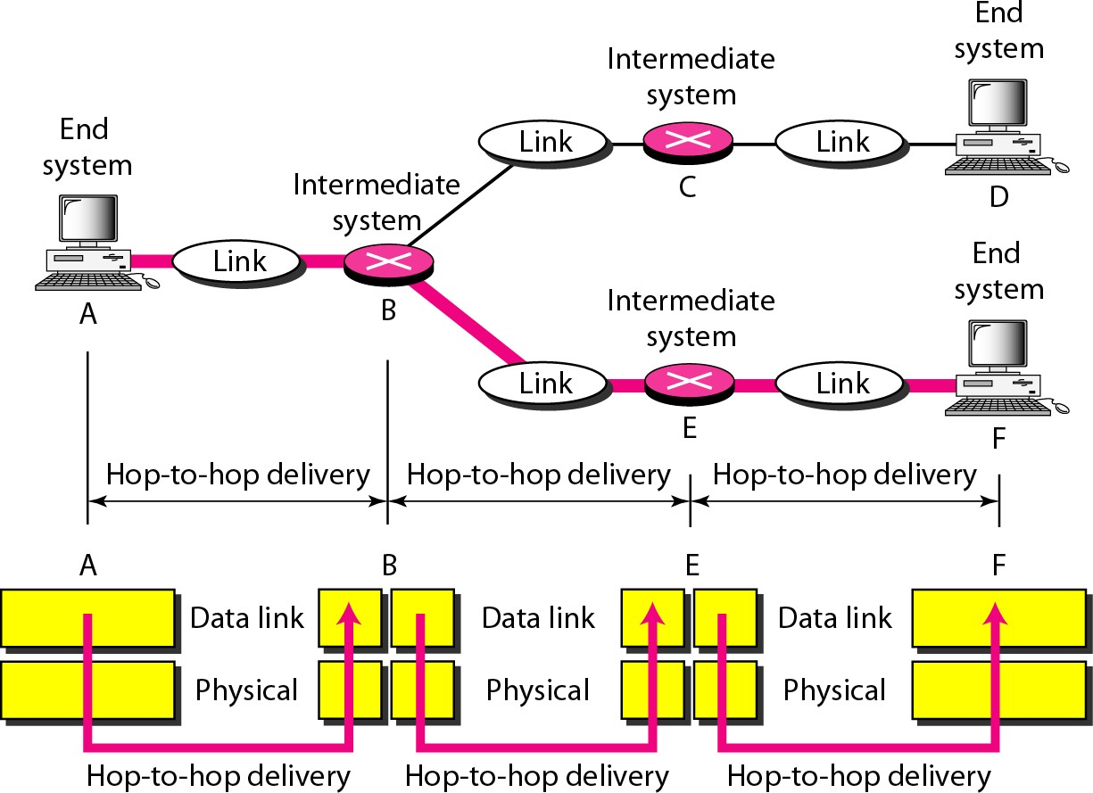
Figure 2.7 Hop-to-hop delivery

Slide 27

Note
The network layer is responsible for the delivery of individual packets from
the source host to the destination host.

Slide 28
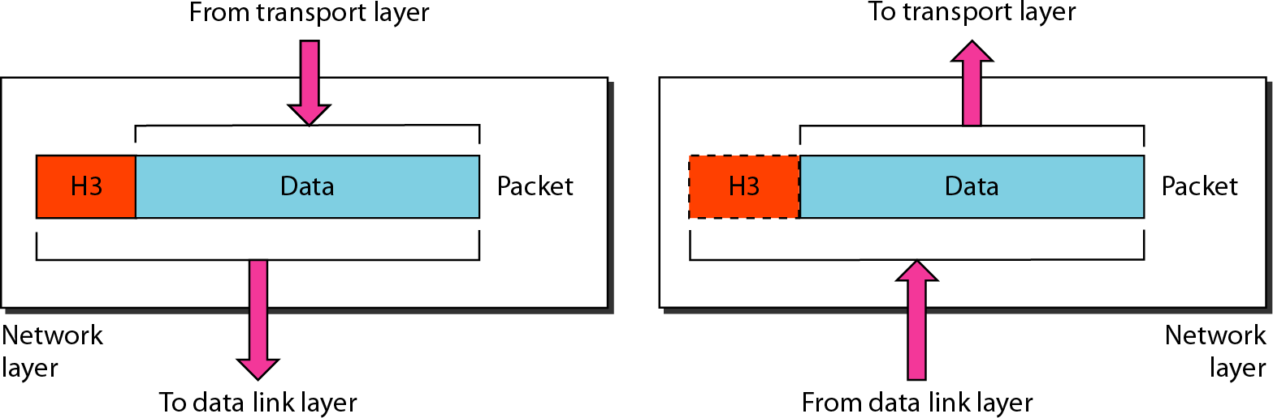
Figure 2.8 Network layer

Slide 29
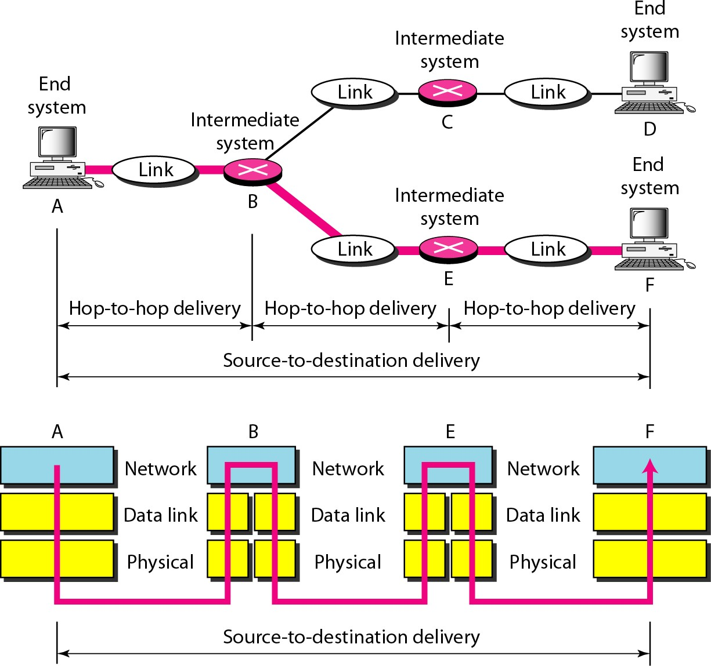
Figure 2.9 Source-to-destination delivery

Slide 30

Note
The transport layer is responsible for the delivery of a message from one process to another.

Slide 31
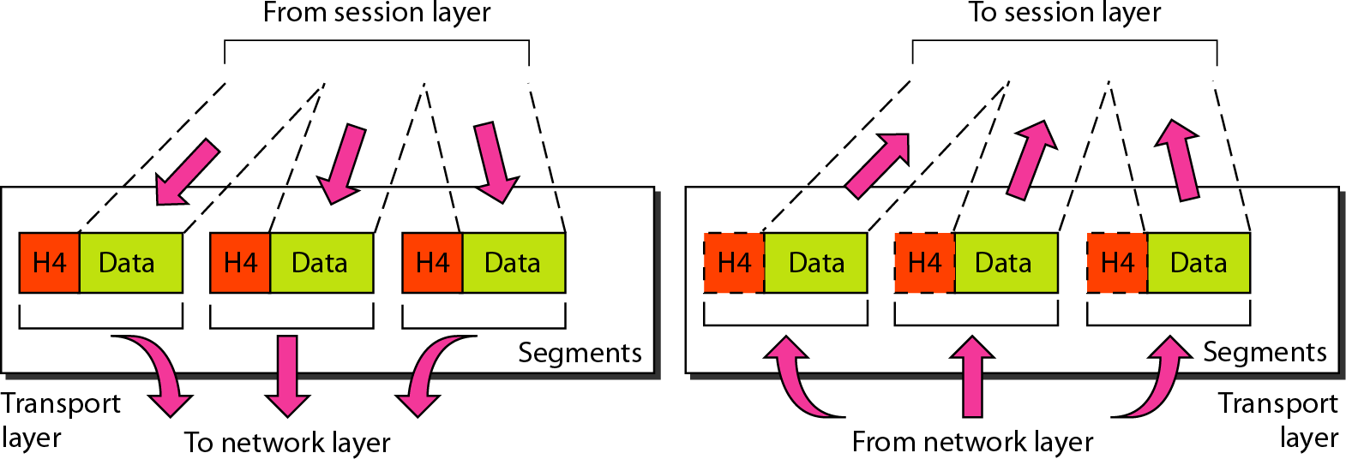
Figure 2.10 Transport layer

Slide 32
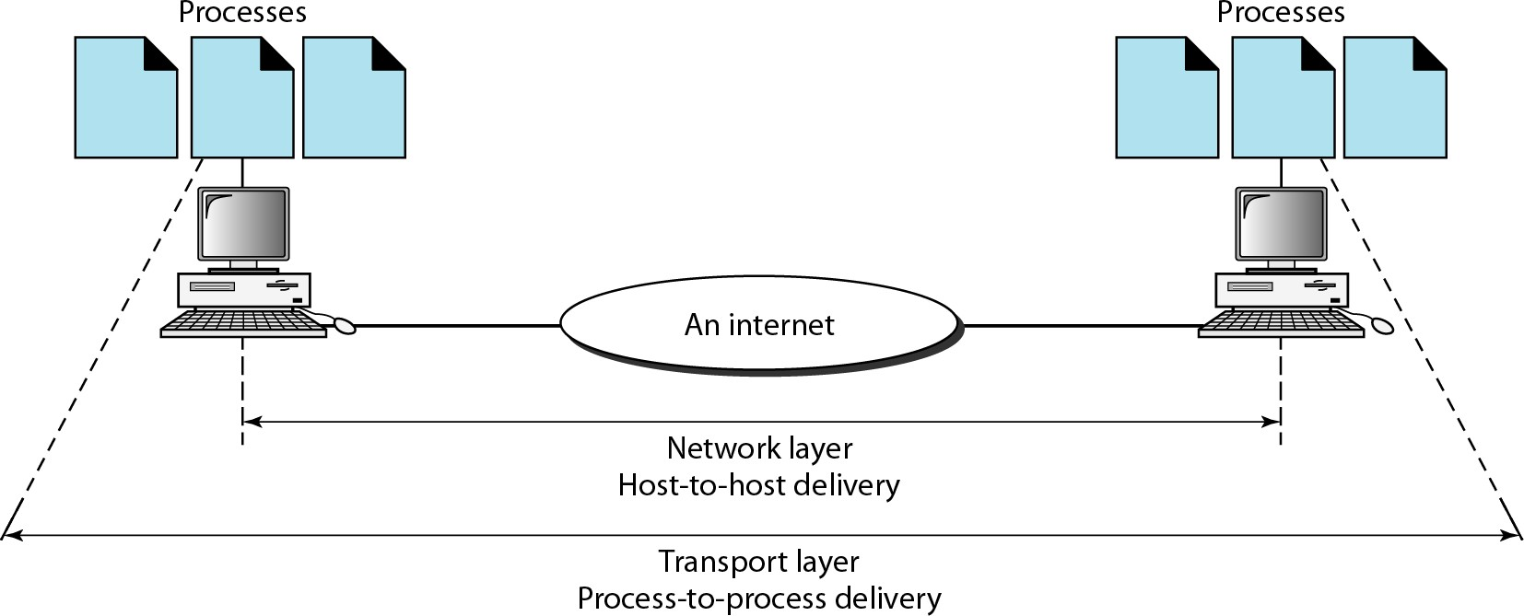
Figure 2.11 Reliable process-to-process delivery of a message

Slide 33
Note
The session layer is responsible for dialog control and synchronization.

Slide 34
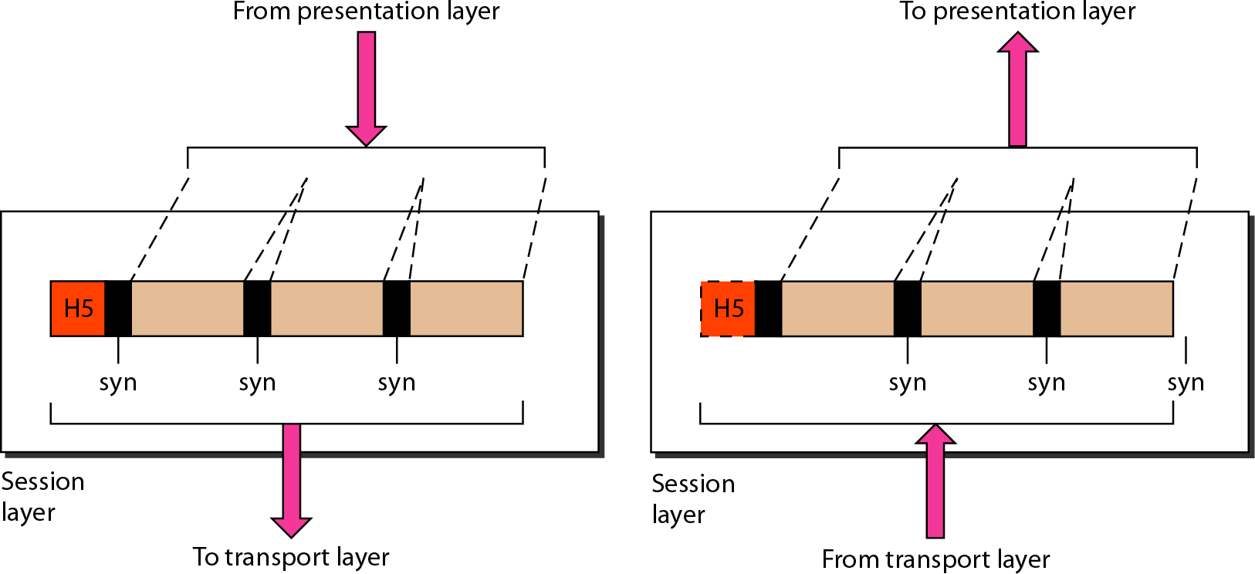
Figure 2.12 Session layer

Slide 35

Note
The presentation layer is responsible for translation, compression, and encryption.

Slide 36
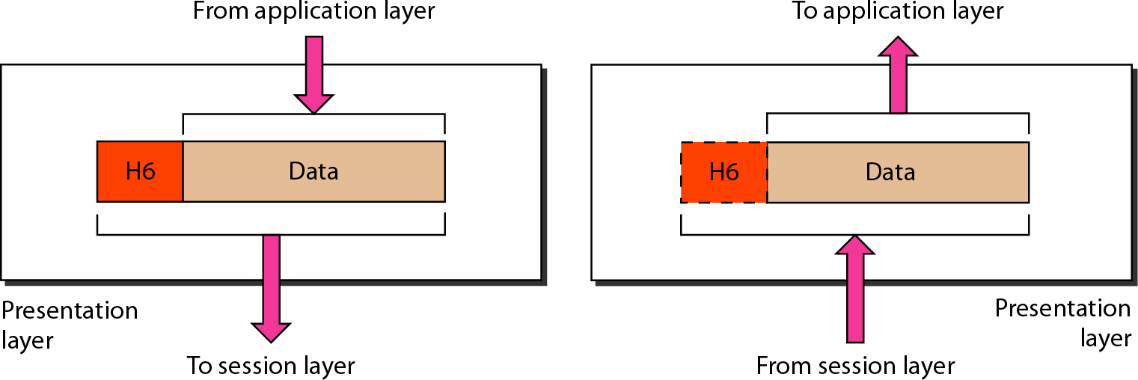
Figure 2.13 Presentation layer

Slide 37

Note
The application layer is responsible for providing services to the user.

Slide 38
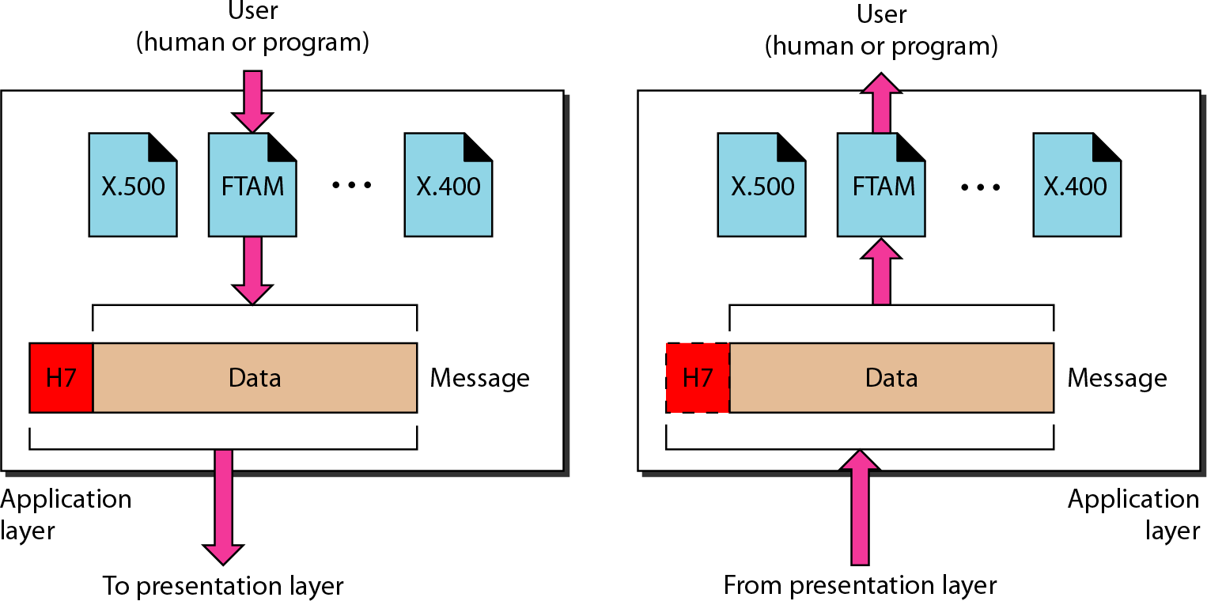
Figure 2.14 Application layer

Slide 39
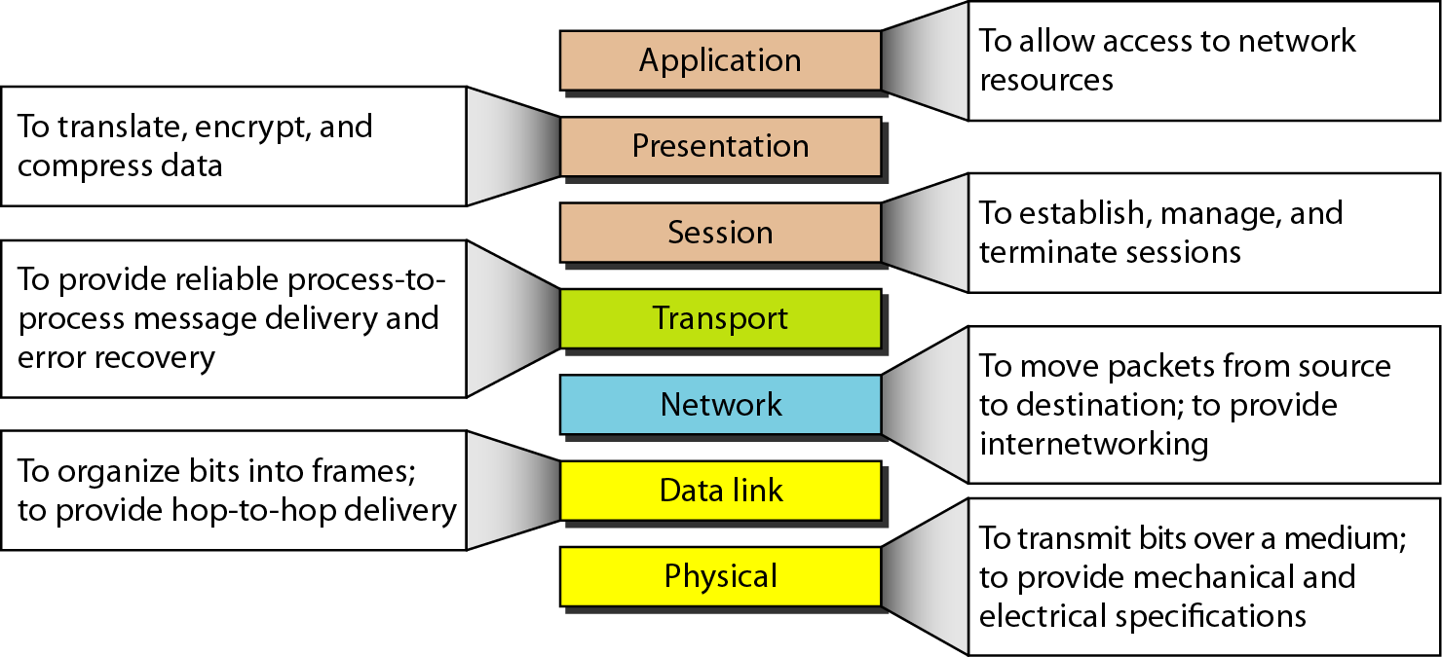
Figure 2.15 Summary of layers

Slide 40






























































TCP/IP PROTOCOL SUITE
The layers in the TCP/IP protocol suite do not exactly match those in the OSI model. The original TCP/IP protocol suite was defined as having four layers: host-to-network, internet, transport, and application. However, when TCP/IP is compared to OSI, we can say that the TCP/IP protocol suite is made of five layers: physical, data link, network, transport, and application.
Topics discussed in this section: Physical and Data Link Layers Network Layer
Transport Layer Application Layer

Slide 41
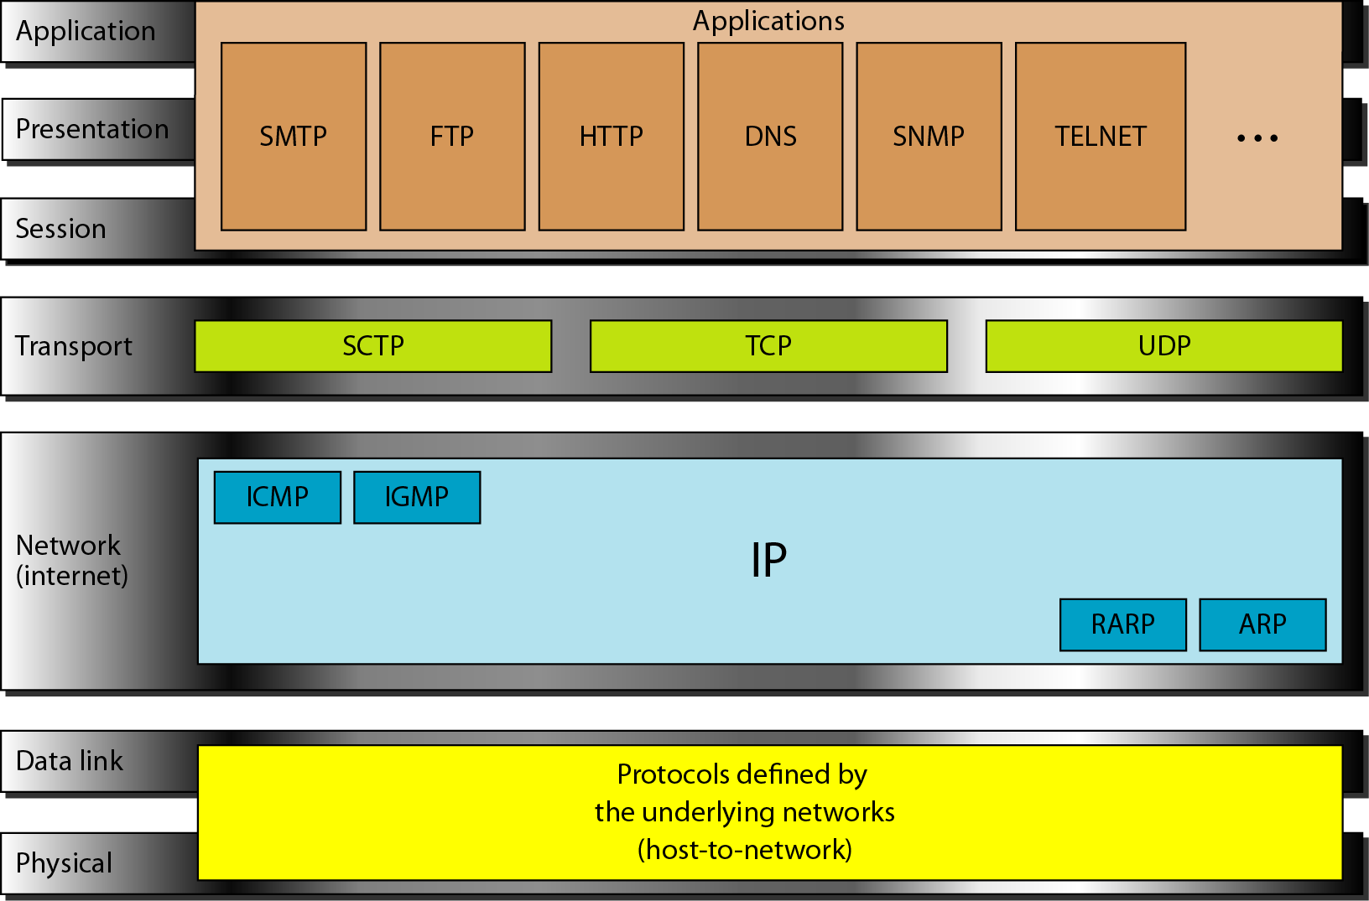
Figure 2.16 TCP/IP and OSI model

Slide 42























ADDRESSING
Four levels of addresses are used in an internet employing the TCP/IP protocols: physical, logical, port, and specific.
Topics discussed in this section:
Physical Addresses Logical Addresses Port Addresses Specific Addresses

Slide 43
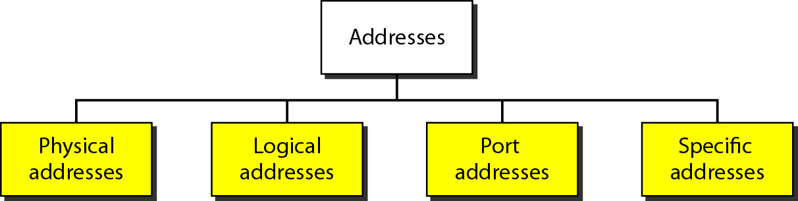
Figure 2.17 Addresses in TCP/IP
Four levels of addresses are used in an internet employing the TCP/IP protocols: physical address, logical address, port address, and application-specific address. Each address is related to a one layer in the TCP/IP architecture

Slide 44
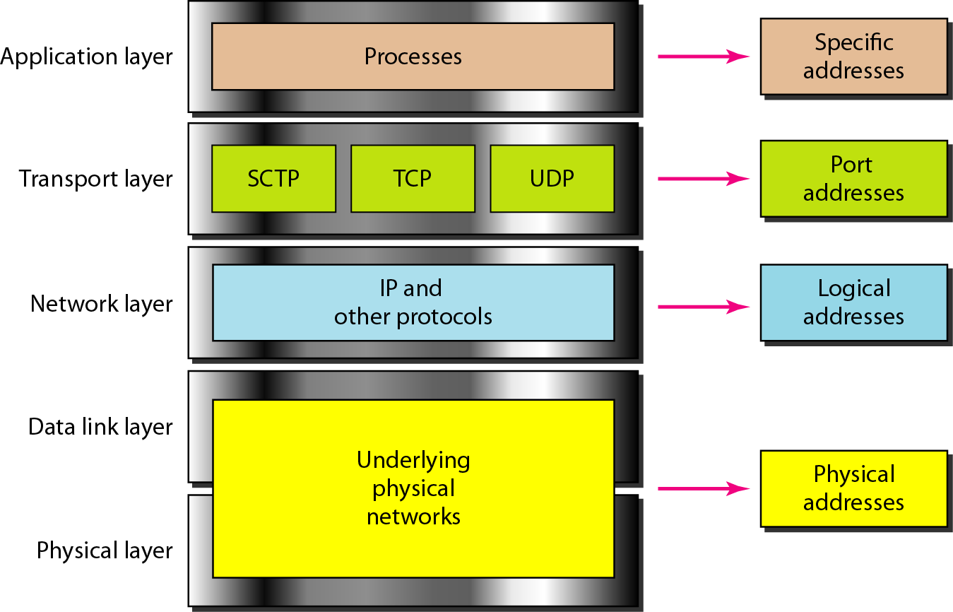
Figure 2.18 Relationship of layers and addresses in TCP/IP

Slide 45
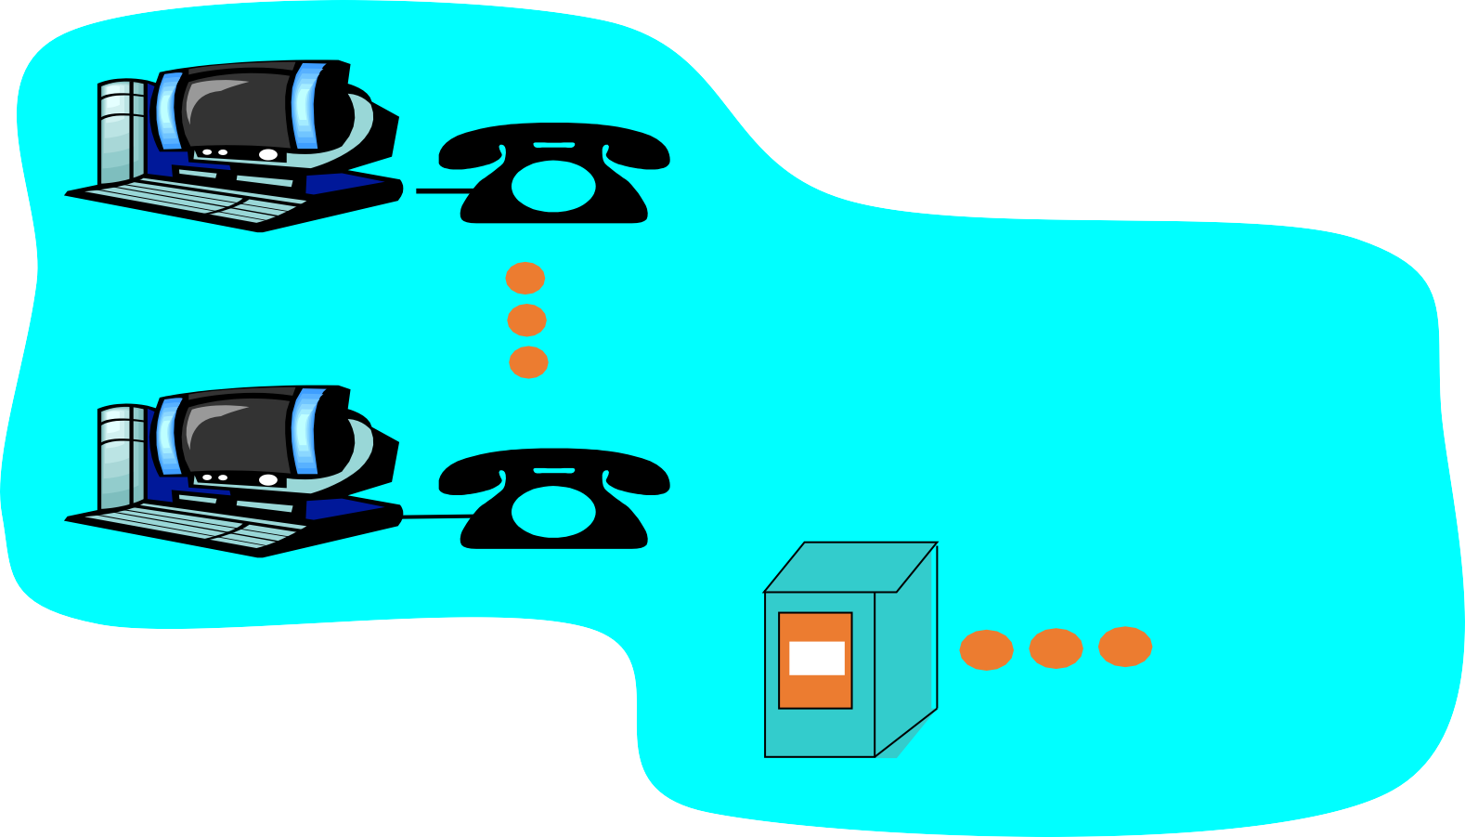
Layering: logical communication
Each layer:
distributed
“entities” implement layer functions at each node
entities perform actions, exchange messages with peers
application
transport
network
link
physical
network
application
transport
network
link
physical
link
physical
application
transport
network
link
physical
application transport network link physical
Introduction

Slide 46
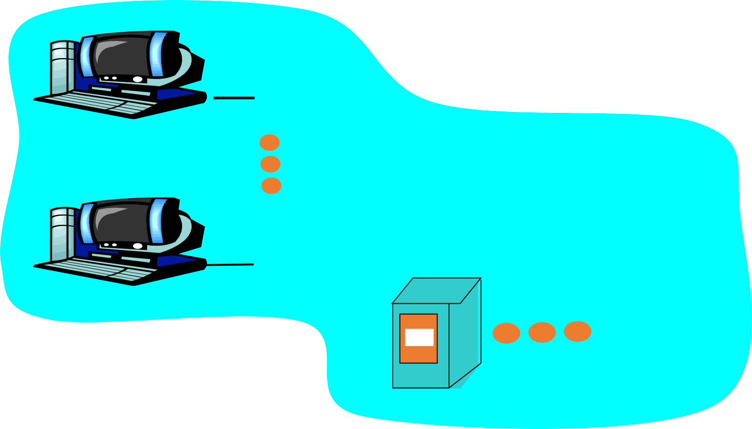
Layering: logical communication
data
E.g.: transport
take data from app
add addressing, reliability check
info to form “datagram”
send datagram to peer
wait for peer to ack receipt
analogy: post office
application
transport
transport
network
link
physical
ack
network link
application
transport
data
physical
network
link
ta
physical
da
application
application
transport
transport
transport
network
netw
ork
link
link
physical
physical
Introduction

Slide 47
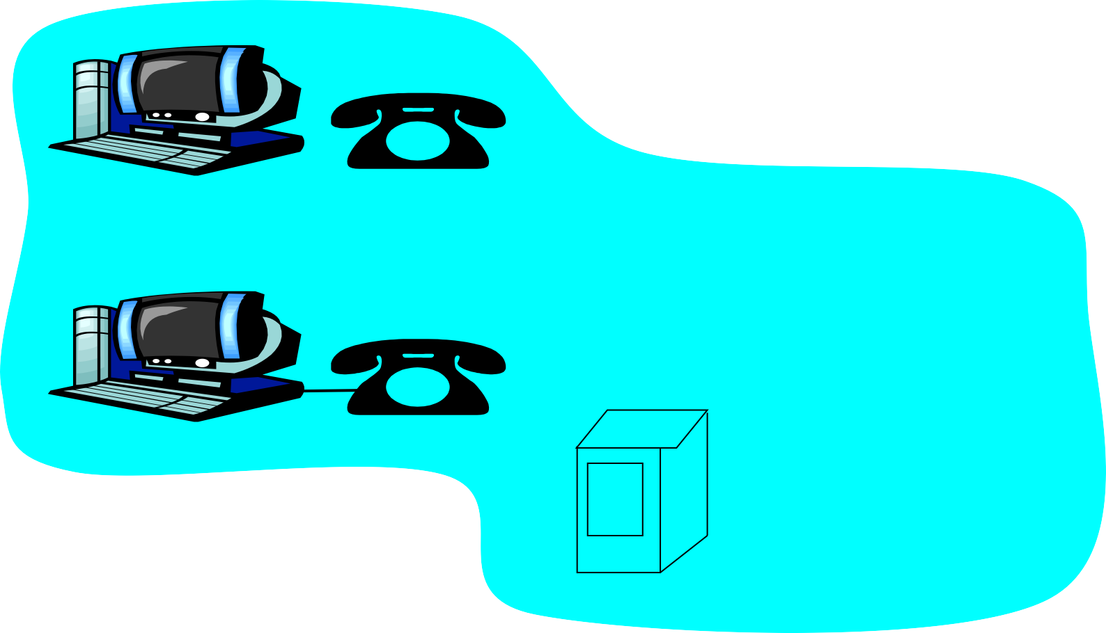
Layering: physical communication
applic ^{data}
ation
transport network link physical
network link physical
application
transport
network
link
physical
d
ata
application
transport
network
link
physical
application transport network
link
physical
Introduction

Slide 48
Protocol layering and data
Each layer takes data from above
adds header information to create new data unit
passes new data unit to layer below
source
destination
M
message segment datagram
frame
M
application
application
transport
transport
H t
M
H t
M
network
network
H n H t
M
link physical
link physical
H n H t
M
H l H n H t
M
H l | H n | H t | M
Introduction

Slide 49



Example 2.1
In Figure 2.19 a node with physical address 10 sends a frame to a node with physical address 87. The two nodes are connected by a link (bus topology LAN). As the figure shows, the computer with physical address 10 is the sender, and the computer with physical address 87 is the receiver.

Slide 50
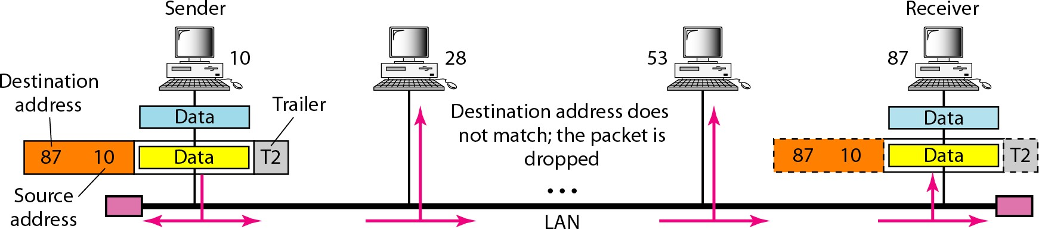
Figure 2.19 Physical addresses

Slide 51


Example 2.2
Most local-area networks use a 48-bit (6-byte) physical address written as 12 hexadecimal digits; every byte (2 hexadecimal digits) is separated by a colon, as shown below:
07:01:02:01:2C:4B
A 6-byte (12 hexadecimal digits) physical address.

Slide 52


Example 2.3
Figure 2.20 shows a part of an internet with two routers connecting three LANs. Each device (computer or router) has a pair of addresses (logical and physical) for each connection. In this case, each computer is connected to only one link and therefore has only one pair of addresses. Each router, however, is connected to three networks (only two are shown in the figure). So each router has three pairs of addresses, one for each connection.

Slide 53
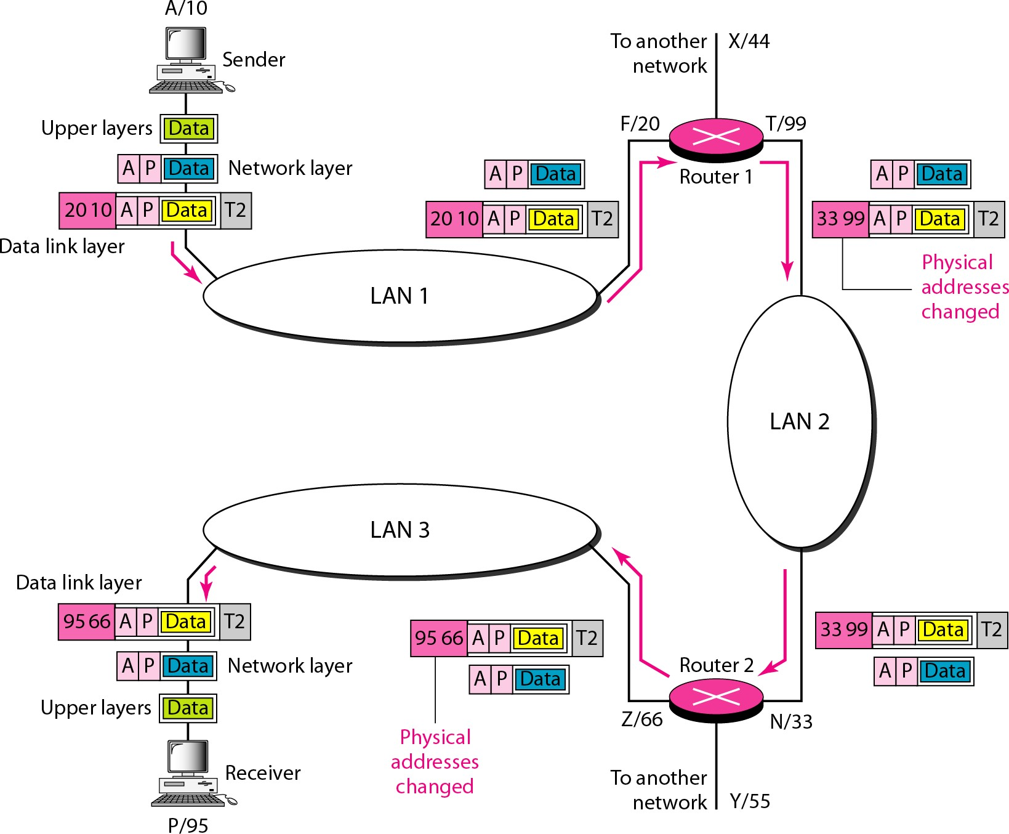
Figure 2.20 IP addresses

Slide 54

Example 2.4
Figure 2.21 shows two computers communicating via the Internet. The sending computer is running three processes at this time with port addresses a, b, and c. The receiving computer is running two processes at this time with port addresses j and k. Process a in the sending computer needs to communicate with process j in the receiving computer. Note that although physical addresses change from hop to hop, logical and port addresses remain the same from the source to destination.

Slide 55
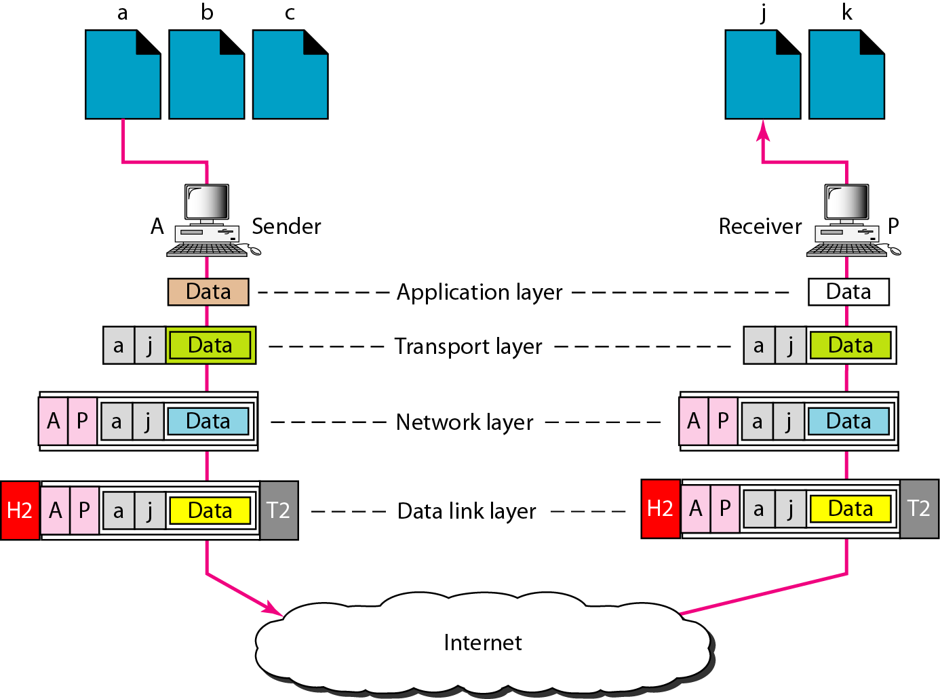
Figure 2.21 Port addresses

Slide 56





